Slide 1

CSE101 Fall 2024 Project
Group 2

Slide 2
Cat Feeder

Slide 3
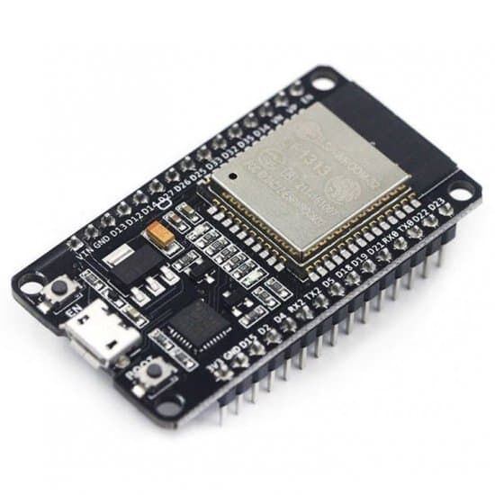
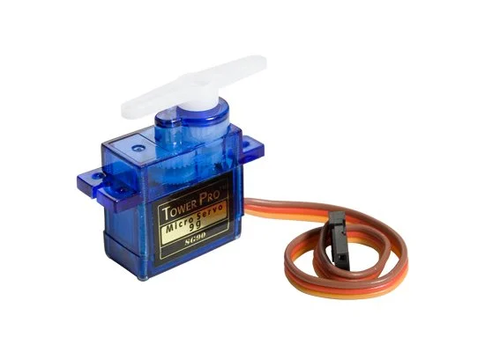
Hardware

Slide 4
Why ESP32
More powerful than Arduino Uno
Has built in Wi-Fi and Bluetooth
Great fit for IoT projects

Slide 5

What we tried to do

Slide 6
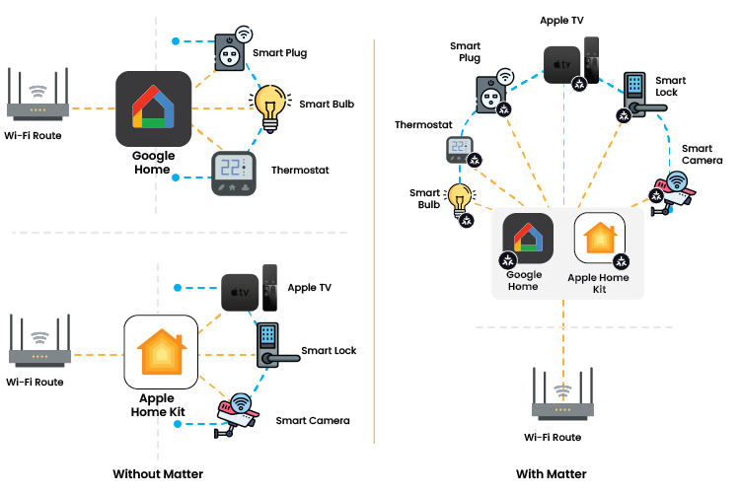
What is Matter

Slide 7
What didn’t work
Everything worked at home
Didn’t work with neither school
network nor hotspot
Turns out Matter requires IPv6

Slide 8
What we learned
Read the documentation carefully

Slide 9
What we did instead
Instead of Matter, we use a web
app to control the feeder

Slide 10
How does it work
Arduino starts a web server
When button is pressed, motor
moves away the obstacle and the
food pours into a bowl

Slide 11
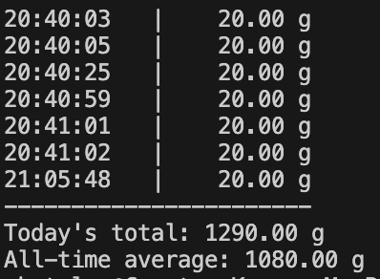
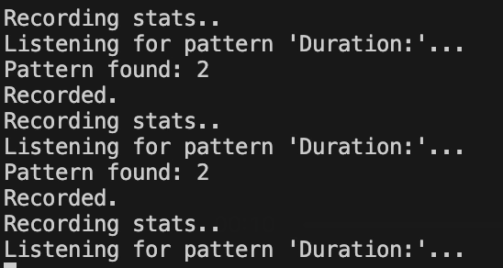
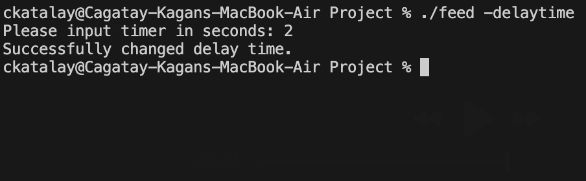
How does it work
Duration gets printed to serial
(desired duration can be changed
with our C program)
Program reads it and records it to
a CSV file and can print stats

